Slide 1
WorkShop #10
Linked Lists

Slide 2
Simplifying Example
10 people are standing in line
Each person has an ID, and only knows who’s standing after him in line.
Each person knows 2 things -
His own ID
Who’s standing after him (Next person in line)
We want to know the ID of all the people standing in line

Slide 3
How can we discover all the ID’s?
We will start from the 1st person in line
Each Person will:
Tell me his own ID
Direct me to the next person in line (point to next in line)
Notice: If person b stands right after person a, Person a can only point at person b, and we will ask b what’s his ID!
The last person in line is the one that has no one to point at - we have discovered all ID’s

Slide 4
Relating to Nodes
10 people are standing in line - 10 Nodes (Person = Node)
Each person has his own ID - Value
Each person knows 2 things:
His own ID - Value
Who’s standing after him (Next person in line) - Next

Slide 5
Node Class
Defines a new type called Node
Each object of type Node has 2 properties/field:
Value - the value it holds (In our example - the ID)
Next - the next node in the list (In our example - the next person in line)
We refer to field “Next” as a pointer points to the next Node in the list

Slide 6
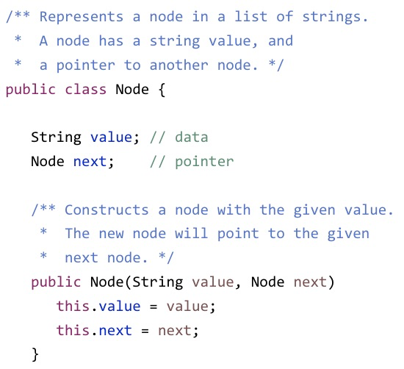
Implementation - class Node
Value
Type: depends on the specific node
In this case the type is String
Next
Type: Node
Pointer to the next Node in the list

Slide 7


Ex #1
Open the file “Node.java”
Implement a constructor function that creates the last node in the list, holding a given value.
Function’s signature:
Notice: The last node points at null
Don’t Forget the principle - DRY!
public Node(int value) {

Slide 8
Back to our example
The 1st person in line is our “Starting point”:
Each person will lead us to the next one in line
Each Person had:
His own ID
Pointer to the next person in line
The last person in line is the one that has no one to point at (null)

Slide 9
Relating to Linked Lists
If I ask you to define the line, how would you do that?
A bunch of people standing one after the other
Each person “leads” to the person after him - points at him
The line in our example is exactly the Linked List!
“A bunch” of nodes connected to one another by pointers
A person in line = a node in the list

Slide 10
Implementation - List
package list;
/** A linked list of integers. */
public class List {
private Node first; // Points to this list
private int size; // Number of elements
/** Constructs an empty list. */
public List() {
// Starts with a dummy node
first = new Node(0);
size = 0;
}
first
Type: Node
Dummy Node - value is “null” and the node is only a pointer to the first real node in the list
size
Type: int
Counts the number of elements in the list

Slide 11
Ex #2
How can we insert to end of list?
Open the file “List.java”
Implement a function that Adds the given value to the beginning of this list:
Notice: in our linked lists, first will always be the dummy node
public void addFirst(int val) {

Slide 12
/** A linked list of integers. */
public class List {
private Node first; // Points to this list
private int size; // Number of elements
...
/** Returns the index of the first occurrence
* of the given value, or -1 if not in list. */
public int indexOf(int val) { // code omitted }
/** If the given value is in the list, removes
* it and returns true. Otherwise, returns false.*/
public boolean remove(int val) {
if (indexOf(val) == -1) return false;
// Creates two lock-step pointers
Node prev = first;
Node current = first.next;
while (current.value != val) {
prev = current;
current = current.next;
}
prev.next = current.next;
current = null; // for object recycling
size--;
return true;
}
Iterating over
a Linked List
Code Review
Can we do better? (Yes! Iterator)

Slide 13
Ex #3
If time permitts, discuss more list methods
Implement the function “indexOf” in List.java.
The function Returns the index of the first occurrence of the given value, or -1 if not in list.
Function signature:
public int indexOf(int val) {
Notice: in our linked lists, first will always be the dummy node

Slide 14
Questions?

